Slide 1

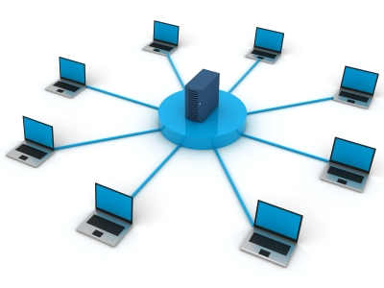
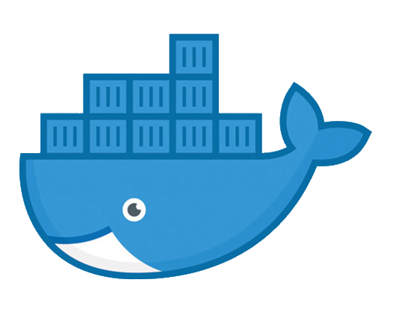
Docker networking

Slide 2
Docker networking
Bridge network. Default or named.
Host
Overlay
Kubernetes

Slide 3
Docker networking Bridge network
The default driver. The default bridge network is used when the network is unspecified Named bridge networks can be created
Hosts connected to the default bridge network can access each other (by IP)
Containers connected to different named bridge networks can’t communicate with each other.
Containers connected to the same bridge network expose all ports to each other and no ports to the outside. Exposing ports to the outside is usually done with docker run -p
Automatic DNS resolution between containers on a named bridge network is provided.

Slide 4
Docker networking Host networking
No isolation between container and host network.
Not supported on Docker for Mac, Docker for Windows, or Docker EE for Windows Server.
No explicit port forwarding is required. Ports available on the container are available on the host
Containers get the Docker hosts hostname and IP
Multiple containers can use this interface on different ports
Communication between containers can take place but not by using container names and only via the host interface

Slide 5
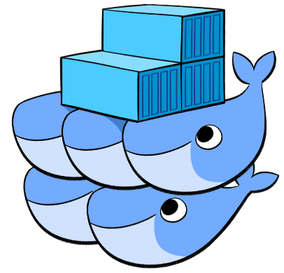
Docker networking Overlay networking
Used with Docker Swarm; native Docker engine clustering
Hosts running on daemons which are part of the same swarm using the same overlay network can access each other by hostname or IP
VirtualBox host 1
VirtualBox host 2
Docker Swarm
Docker daemon 1
Docker daemon 2
Overlay network
Container 1
Container 2
https://docs.docker.com/network/network-tutorial-overlay/

Slide 6
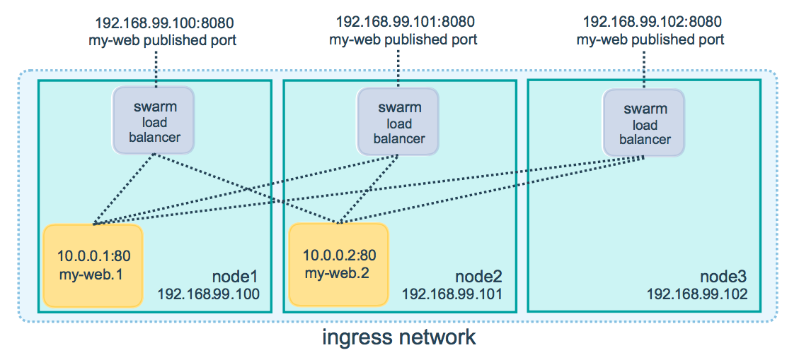
Docker networking Overlay networking
Docker Swarm does load balancing of exposed service ports

Slide 7
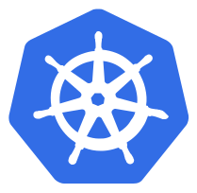
Docker networking Kubernetes
Kubernetes uses a service mesh or custom network drivers with more flexibility Official drivers: Calico, Canal, Flannel, Kube-Router, Romana and Weave Net
Fundamental requirements
all containers can communicate with all other containers without NAT
all nodes can communicate with all containers (and vice-versa) without NAT
the IP that a container sees itself as is the same IP that others see it as
Used mainly to use network fabrics with Kubernetes like
Google Cloud Engine network fabric
Oracle Virtual Cloud Network
https://kubernetes.io/docs/concepts/cluster-administration/networking/

